Slide 1
Link Aggregation Control Protocol
-Rajesh Nadiminti

Slide 2
What is LACP?
IEEE802.1AX-2008
Link aggregation, is a method of combining multiple physical network links into a single logical link for increased performance.
LACP provides a standardized means for exchanging information between partner systems on a link to allow their link aggregation control instances to reach agreement on the identity of the LAG to which the link belongs, and then to move the link to that LAG, and to enable the transmission and reception processes for the link to function in an orderly manner.

Slide 3
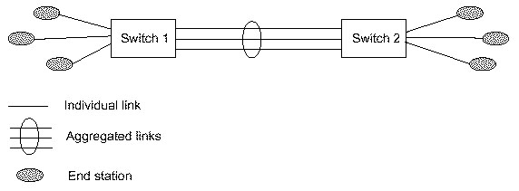
General View

Slide 4
Advantages of LACP
Automatic Recovery
Increased communication speed
Securing redundancy
Improve fault tolerance
Distributed data transmission

Slide 5
Types of approaches
Static approach
Dynamic approach

Slide 6
Static Method
Each network device is instructed directly
With a static link aggregate, all configuration settings will be setup on both participating LAG (Link Aggregation Groups) components.

Slide 7
Dynamic approach
Link Aggregation Control Protocol (LACP) allows the exchange of information with regard to the link aggregation between the two members of said aggregation. This information will be packetized in Link Aggregation Control Protocol Data Units (LACDUs).
Each individual port can be configured as an active or passive LACP using the control protocol.
Passive LACP: the port prefers not transmitting LACPDUs. The port will only transmit LACPDUs when its counterpart uses active LACP.
Active LACP: the port prefers to transmit LACPDUs and thereby to speak the protocol, regardless of whether its counterpart uses passive LACP or not.

Slide 8
Advantages over Static Link Aggregation
Failover occurs automatically: Even if one physical links fails, it will detect if the point-to-point connection is using a media converter, so that the link status at the switching port remains up. Because LACPDUs (special frames exchanged by sides which contains 128 octets of actor and partner information) do not form a component of this connection, the link will be removed from the link aggregate. This ensures that packets will not be lost due to the failed link.
Dynamic configuration: The device can confirm that the configuration at the other end can handle link aggregation. With Static link aggregation a cabling or configuration mistake could go undetected and cause undesirable network behavior

Slide 9
Installation
Install VMWare
Download Mininet from https://github.com/mininet/mininet/wiki/Mininet-VM-Images and install in VMWare
Install all in one SDN controller from http://webcache.googleusercontent.com/search?q=cache:R4Of7hNEVhoJ:sdnhub.org/tutorials/sdn-tutorial-vm/+&cd=1&hl=en&ct=clnk&gl=us&client=safari and install in VMWare

Slide 10
Configuring RYU Controller
Open All in One SDN Controller and change the directory to RYU
Cd /home/ubuntu/ryu
Update the folder to latest version
Git pull

Slide 11
Configuring Mininet
Open Mininet and configure the custom configuration file as per requirement.
Cd mininet/custom
Create a new topology
vim lacp.py

Slide 12
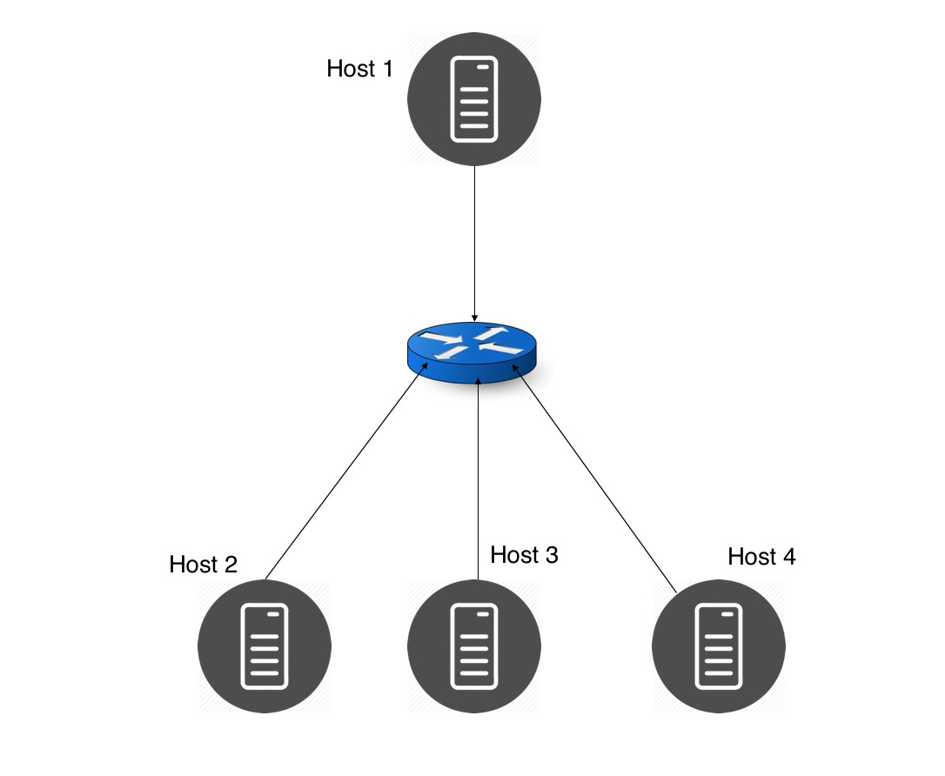
Creating custom topology
I considered 4 hosts and one switch and they are connected as shown below

Slide 13
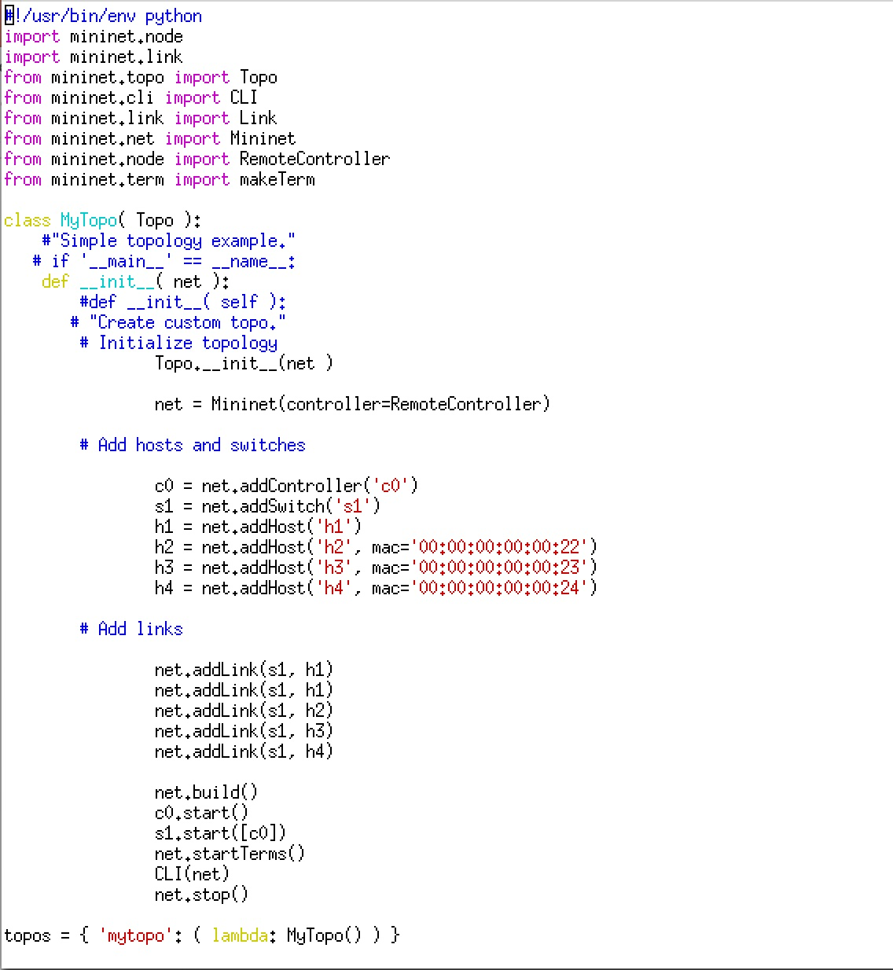
Creating Custom Topology (Cont.)

Slide 14
Running RYU Controller and mininet topology
Write a Python Code that uses OpenFlow version 1.3 simple_switch_lacp_13.py
Run the controller with modified LACP code using the command below
Cd ryu
./bin/ryu-manager ryu/app/simple_switch_lacp.py –verbose
Run the mininet topology using following command
sudo mn --custom lacp.py --topo mytopo --mac --switch ovsk, -- protocol = OpenFlow13, controller=remote,ip=172.16.46.131,port=6633

Slide 15
Configuring nodes (h1)
Once we run the controller we will be prompted with nodes to configure
The prompted nodes are h1,h2,h3,h4,s1,c0
First we need to load bonding driver inorder to perform link aggregation.
Create the bonding.conf file
/etc/modprobe.d/bonding.conf
Bonding.conf :
alias bond0 bonding
options bonding mode=4
mode=4 indicates that dynamic link aggregation is performed using LACP
Load the driver using
modprobe bonding

Slide 16
Configuring nodes (h1) (cont.)
Create a new logical interface named bond0 and set a value for mac address of bond0
ip link add bond0 type bond
ip link set bond0 address 02:01:02:03:04:08
Add physical interfaces h1-eth0 and h1-eth1 to the local interface group.
ip link set h1-eth0 down
ip link set h1-eth0 address 00:00:00:00:00:11
ip link set h1-eth0 master bond0
ip link set h1-eth1 down
ip link set h1-eth1 address 00:00:00:00:00:12
ip link set h1-eth1 master bond0

Slide 17
Configuring nodes (h1) (cont.)
Assign IP address to logical interface and delete IP address assigned for h1-eth0
ip addr add 10.0.0.1/8 dev bond0
ip addr del 10.0.0.1/8 dev h1-eth0
Now make the logical Interface “UP”
ip link set bond0 up

Slide 18
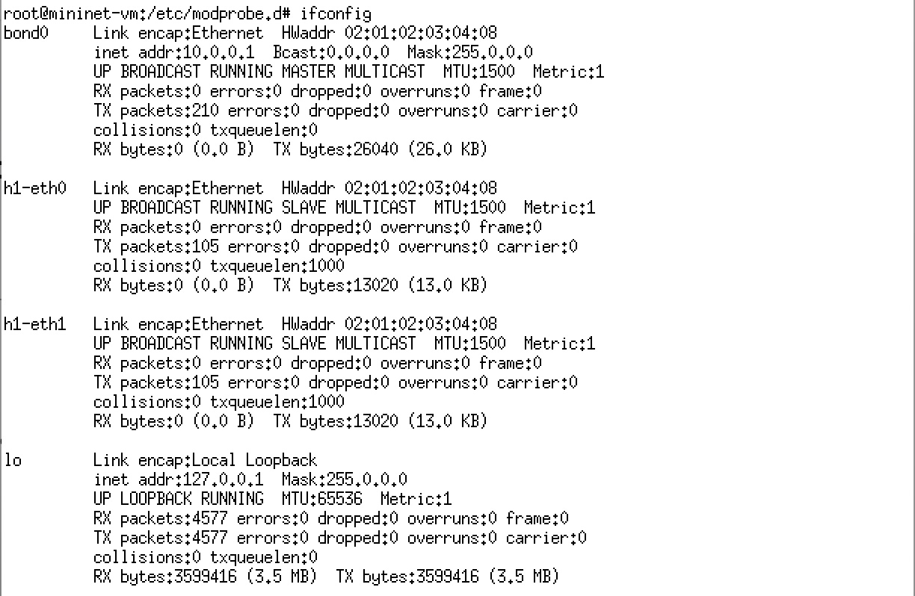
Configuring nodes (h1) (cont.)
Check the state of each interface

Slide 19
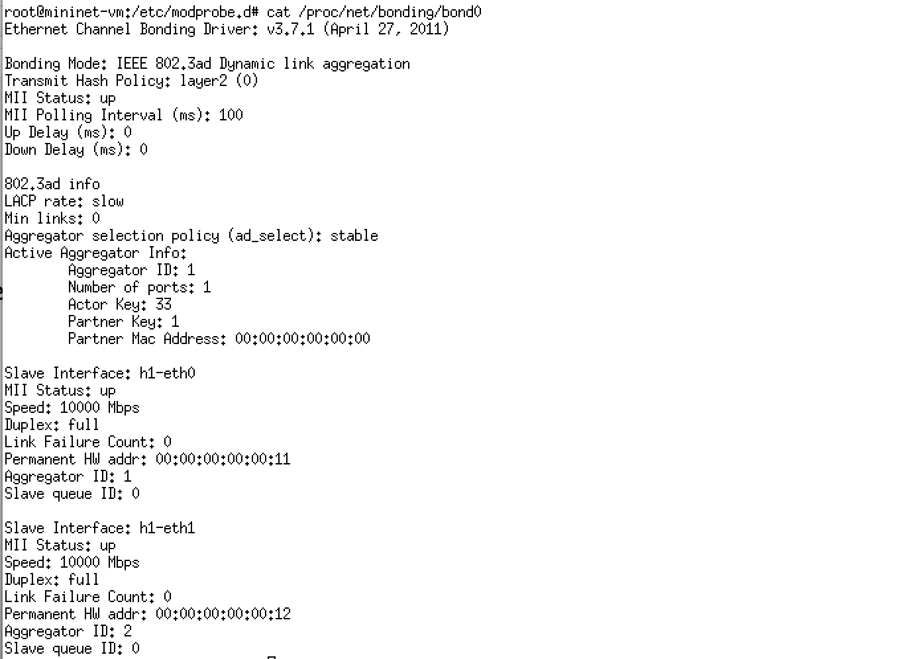
Configuring nodes (h1) (cont.)
Check the state of bonding driver

Slide 20
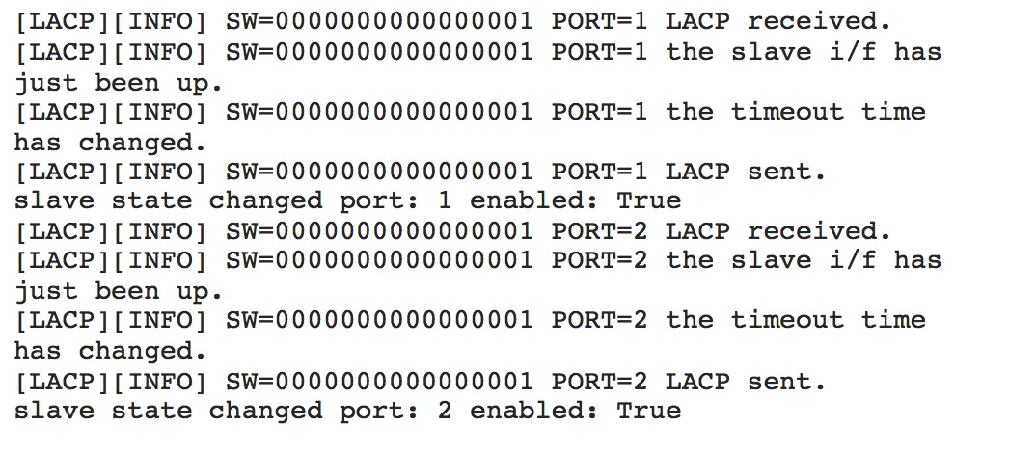
Configuring nodes (s1,c0) (cont.)
Set the OpenFlow version of switch to 1.3
ovs-vsctl set Bridge s1 protocols=OpenFlow13
Host h1 sends one LACP data unit every 30 seconds

Slide 21
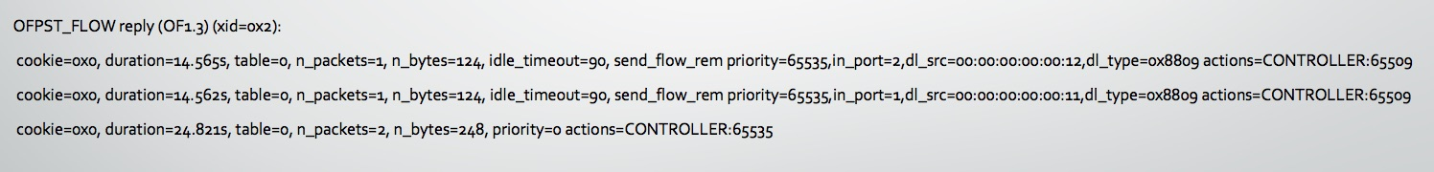
Checking the Flow entry
In the switch s1 type the following command to check the flow entry
ovs-ofctl -O openflow13 dump-flows s1

Slide 22
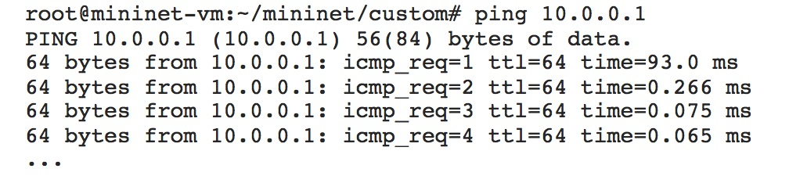
Checking LACP Function
Improving Connection Speed:
Ping h1 from h2/h3/h4 and check the amount of time it took

Slide 23
References
https://en.wikipedia.org/wiki/Link_aggregation
https://www.thomas-krenn.com/en/wiki/Link_Aggregation_and_LACP_basics#Static_Link_Aggregation
http://www.slideshare.net/NetPlus/at8000-s-configurando-trunking?next_slideshow=1
https://github.com/osrg/ryu/wiki/OpenFlow_Tutorial
http://mininet.org/walkthrough/
https://github.com/mininet/mininet/issues/546
https://osrg.github.io/ryu-book/en/html/link_aggregation.html

